Slide 1
Computer Architecture
----A Quantitative Approach
2023.fall

Slide 2
Instructor & TA
Instructor： 何水兵
Office : Room 211, Bld. of ZeTong
Mobile: 18986211726
Email: heshuibing@zju.edu.cn
Homepage:
https://person.zju.edu.cn/heshuibing
https://shuibing9420.github.io
TA：宋浩喆
Mobile：18265882658
Email：haozheshz@zju.edu.cn
Course Website： course.zju.edu.cn

Slide 3
Why we learn Computer Organization?
Hardware Course Series
并行处理
Parallel Processing
高级计算机体系结构
Advanced CA
分布式系统
Distributed System
存储技术基础
Storage Technology Fundations
接口设计
Interface Design
计算机体系结构
Computer Architecture
嵌入式系统
Embedded System
多核程序设计
Multicore Programming
计算机组成
Computer Organization
逻辑与计算机设计基础
Logic and Computer Design Fundamentals
电子线路
Electronic Circuits
模拟线路
Simulation Circuis

Slide 4
Why we learn Computer Organization?
编译系统
计算机网络
嵌入式系统
大学三年级
操作系统
计算机体系结构
汇编与接口
计算机组成
数据库系统
大学二年级
高级数据结构与算法分析
数字逻辑设计基础
数据结构基础
计算机系统概论
大学一年级
通识课程
C语言程序设计
大学计算机基础

Slide 5
Course Objectives
The objective of this course
systemically learn the fundamental concepts and design approaches of computer architecture from the view of the whole computer system.
Learn the hardware design approaches and to use hardware design toolkits skillfully.
learn to implement pipelined CPU and a simple memory hierarchy.
Notes:
This course is opended for both the sinor undergraduate students and MD graduate students.
The objective of this course is to introduce the fundamental techniques on which high-performance computing is based, and to develop the foundations for analyzing the benefits of design options in computer architecture.

Slide 6
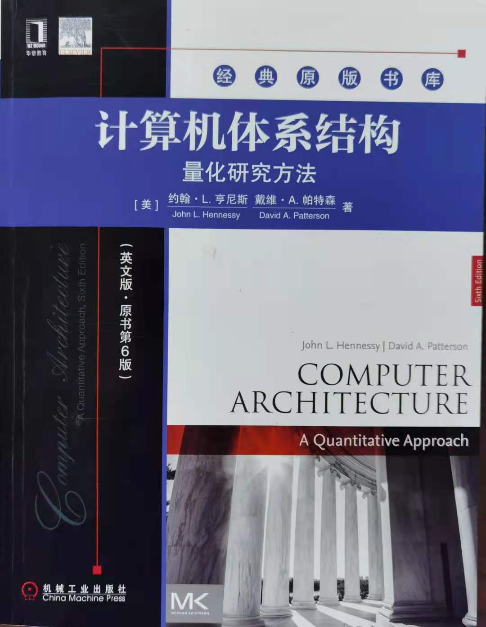
Textbook
David A. Patterson, John L. Hennessy,
《Computer Architecture
– A Quantitative Approach》
6th Edition. July , 2019.

Slide 7
Difference of 6th & 5th edition
Most significant change:
ISA selection
5th MIPS
6th RISCV
Add a new chapter:
Chapter 7 Domain-Specific Architecture(DSA)
CPU/GPU/DNN accelerator comparison
Other change:
Remove description of Delayed Branch
RISCV removes it because the performance of branch predicter is powerful enough.
Book size limitation:
More contents move to Appendix and CD
Notes:
Most significant change is
Due to computer technology evolvement, the first three editions focused primarily on Instruction level Parallelism, But the 4th edition have a equal focus on Thread level parallelism. And Data-level parallelim.
Put more emphasis on Dependability and topics of power, because power becomes the dominant factor in determine how much circus can be placed on a chip.
Because the book size of 3rd edition is already large enough. The 4th edition would become unacceptable if the book size are too large. Some contents and materials are moved to companion CD.

Slide 8

John L. Hennessy （Stanford）
Former President of Stanford University during 2000 – 2016 （17 billion）
Current Alphabet Chairman
"Godfather of Silicon Valley,“
In 1981, Hennessy initiated a project at Stanford that focused on a simpler computer architecture known as RISC. During a sabbatical leave in 1984-85 he cofounded MIPS Computer Systems, now known as MIPS Technologies, which specializes in the production of microprocessors SPARC.
Received Eckert-Mauchly Award in 2001
Received Turing Award in 2017
https://engineering.stanford.edu/people/john-hennessy
Notes:
MIPS (originally an acronym for Microprocessor without Interlocked Pipeline Stages) is a RISC microprocessor architecture developed by MIPS Technologies.
In 1990’s it’s estimated that one of the three RISC chip were based on MIPS.
MIPS CPU architecture greatly influenced later RISC architectures. DEC alpha is one instrance.

Slide 9
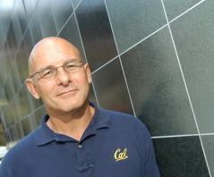
David A. Patterson （ UC Berkeley）
UC Berkeley （ 1976 – 2016 ）
Currently Google TPU
He led the design and implementation of RISC I (the foundation of the SPARC architecture )
Inventor of RAID
involved in the Network of Workstations (NOW) project
Research Accelerator for Multiple Processors (RAMP)
Received ACM Eckert-Mauchly Award in ISCA 2008
Received Turing Award in 2017
https://people.eecs.berkeley.edu/~pattrsn/
Notes:
RISC: Reduced Instruction Set Computer
emphasizing the insight that simplified instructions which "do less" may still provide for higher performance if this simplicity can be utilized to make instructions execute very quickly.
RISC families include DEC Alpha, ARM, MIPS, PA-RISC, Power Architecture (including PowerPC), SuperH, and SPARC.
SPARC: Scalable Processor Architecture, RISC microa-rchitecture Instruction Set Arcthitecture designed by SUN microsystem in 1985.
RAID: Redundant Array of Independent Disks. Inexpensive.
A Case for Redundant Arrays of Inexpensive Disks, 1988, two key design goals: increased data reliability and increased input/output performance.
NOW: Network of Workstation.
The RAMP Gold project is a new effort to produce fully parameterized manycore emulations using FPGAs to help accelerate hardware and software research
ISCA: International Symposium on Computer Architecture.

Slide 10
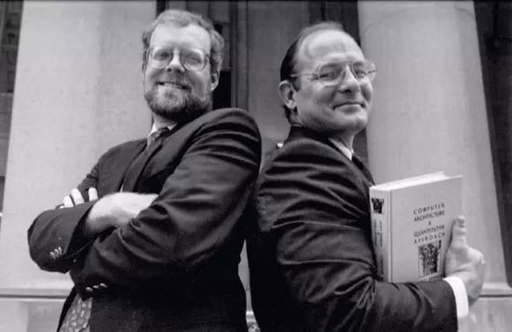


2018 interview
For pioneering a systematic, quantitative approach to the design and evaluation of computer architecture with enduring impact on the microprocessor industry.
This book is essential reading for those tasked with leading any complex enterprise in the academic, not-for-profit, or for-profit sector.
https://baijiahao.baidu.com/s?id=1607140815624945357&wfr=spider&for=pc
Notes:
This is the picture taken when he received the Eckert-Mauchly Award on ISCA’2008.

Slide 11
Prerequisite:
Computer Organization
Survey:
Digital Logical Design
Computer Organization
Operating Systems
Techniques of Compiling / Fundamentals of Compiling

Slide 12
Topics in CA:
Input/Output and Storage
Disks, WORM, Tape
RAID
Emerging Technologies
Interleaving
Bus protocols
DRAM
Memory
Hierarchy
Coherence,
Bandwidth,
Latency
L2 Cache
Network
Communication
Other Processors
L1 Cache
Addressing,
Protection,
Exception Handling
VLSI
Instruction Set Architecture
Pipelining, Hazard Resolution,
Superscalar, Reordering,
Prediction, Speculation,
Vector, Dynamic Compilation
Instruction
Level Parallelism

Slide 13
Computer Architecture Topics
Shared Memory,
Message Passing,
Data Parallelism
P
M
P
M
P
M
P
M
° ° °
S
Interconnection Network
Network Interfaces
Processor-Memory-Switch
Topologies,
Routing,
Bandwidth,
Latency,
Reliability
Multiprocessors
Networks and Interconnections
MCP: Multi-Core Processor
(Chip level Processor)

Slide 14
Topics in this Class (6th. Edition)
 | Topic | Reference
Ch1. | Fundamentals of Quantitative Design and Analysis (Quantitative principles) | Chapter 1
Review | Pipelining: Basic and Intermediate Concepts (How to design a pipelined CPU) | Appendix C
Ch2. | Memory Hierarchy Design (How to improve cache and memory) | Chapter 2 Appendix B
Ch3. | Instruction-Level Parallelism and Its Exploitation (How to implement dynamic scheduling) | Chapter 3 Appendix A
Ch4. | Data-Level Parallelism in Vector, SIMD, and GPU Architectures | Chapter 4
Ch5. | Thread-Level Parallelism | Chapter 5

Slide 15
Different from Organization
Part & Whole
Bottom up & Top down
How & Why

Slide 16
Course Objectives
The objective of this course
Introduce the fundamental techniques on which high-performance computing is based,
Develop the foundations for analyzing the benefits of design options in computer architecture.
Notes:
This course is opended for both the sinor undergraduate students and MD graduate students.
The objective of this course is to introduce the fundamental techniques on which high-performance computing is based, and to develop the foundations for analyzing the benefits of design options in computer architecture.

Slide 17
How ?
Concepts, Ideas and Principles
Quantitative approaches
Hit the problem and right way to solve problem
As a man sows, so he shall reap.
一分耕耘一分收获

Slide 18
What we most care about ?
For the designer, need to know why ?
Know the principle & the way to evaluate
make decision / make choice.
For the designer, need to know universal approach
Investigate → problem→ solve, make decision →Implement → Evaluate

Slide 19
Grading Policy:
20%: written homework
40%: Lab assignments
8%: Bonus
lab grade = report (40%) +check(60%)
40%: Final exam
(close-book test with one A4 memo)
Attendance : deduct one point for each absence
Final grade = 40%(Final exam） + 60%(Lab + Homework) - Attendance deduction.
60% ( <=60 )

Slide 20
Homeworks (20%)
Total 4 times, once per chapter
Submission deadline will be normally one week after assigned, and will be announced on course website.
For doing homework, discussion is greatly encouraged, but every student is required to Do and Submit the homework individually on time.
Submission Naming rule
StID_name_hw1.doc

Slide 21
Lab assignments 40%
Objective
Implement a pipelined CPU with simplified interruption and memory hierarchy composed of a memory and a cache supporting fundamental RISCV-32I instructions via Verilog in Xilinx Vivado on SWORD-V4 board
How
Do the lab by group with 2 persons and submit lab report to website individually.
Do the 6 lab assignments gradually, examine results each time
Submit 6 lab reports
Grading
Lab1-6: 8%, 6%, 4%, 6%， 8%, 8%

Slide 22
Lab assignments 40%
Lab1 (8’ 3weeks): Implement pipelined CPU with forwarding paths and prediction-not-taken supporting RISC V 32i instructions.
Lab2 (6’ 2weeks): Implement Interruption and Exception on Pipelined CPU of Lab 1).
Lab3 (4’ 1week): Implement a 2-way associative cache
Lab4 (6’ 2weeks): Adding the cache into the pipelined CPU in Lab 2).
Lab5 (8’ 3weeks): Expend the pipelined CPU to support multi-cycle operations: integer multiplier, integer divider / remainder operation, issue in order and complete out of order, detecting pipeline hazards ( WAW, RAW)
Lab6 (8’ 5weeks): Implement the Dynamic Scheduling (Scoreboard or Tomasulo), implement a dynamic scheduling pipelined CPU.
Bonus (8’ ): For novel design and implementation. 2’ for each lab and 8’ at most.

Slide 23
Submission Policy:
All the homeworks and lab assignments are required to be submitted to the course website on time.
Submission deadline will be announced on course website.
All assignments in this course should be turned in by the specified due date. Late assignment will be penalized 10% every three days late. However, late assignment more than 6 days is NOT accepted.

Slide 24
Honest Policy
Be HONEST in your work!
Found copy & be copied in the homework or lab report ，you get ZERO for one submission and also get 10% off in the final grade !

Slide 25
Q&A
??

